Slide 1


Department of Computer Science and Engineering
GE19612 – PRIEE
A NOVEL WEB BASED APPROACH TO REDISTRIBUTE EXCESS FOOD
Karan Balaji R S-210701105
Vikram S-210701504
Kanaga Shanmugam P-210701103

Slide 2
Problem Statement and Motivation
Food waste and food insecurity are major issues, with vast amounts of edible food discarded while many people go hungry.
This project aims to bridge this gap by developing a web application that connects food donors with local NGOs for efficient food redistribution.
The motivation is to create a sustainable solution that reduces waste, alleviates hunger, and fosters community engagement.
By taking advantage of technology, we aim to make it easy for individuals and businesses to donate surplus food, thereby promoting a culture of sharing and responsibility, and contributing to a more equitable and sustainable food system.

Slide 3
Objectives
The aim of this project is to develop a web application that connects food donors with local NGOs to efficiently redistribute surplus food, thereby reducing food waste and addressing food insecurity.
The app will enable donors to post details and locations of excess food, and NGOs to view, book, and collect donations promptly.
Key objectives include implementing real-time updates and notifications for seamless communication, optimizing collection logistics based on location data, and awareness about importance of reducing food waste and combating hunger.

Slide 4
Abstract
This project introduces a web app designed to reduce food waste and help those in need by connecting food donors with local NGOs. Built with HTML, CSS, Javascript and PHP, the application provides an easy-to-use platform where people, restaurants, and businesses can post details about extra food they have.
This includes information like the type of food, how much there is, when it expires, and where it’s located. NGOs can use the app to see a list of available food donations nearby.
They can book the donations they need and arrange to pick them up from the donor’s location. This simple process helps NGOs quickly find and collect food, saving time and resources.

Slide 5
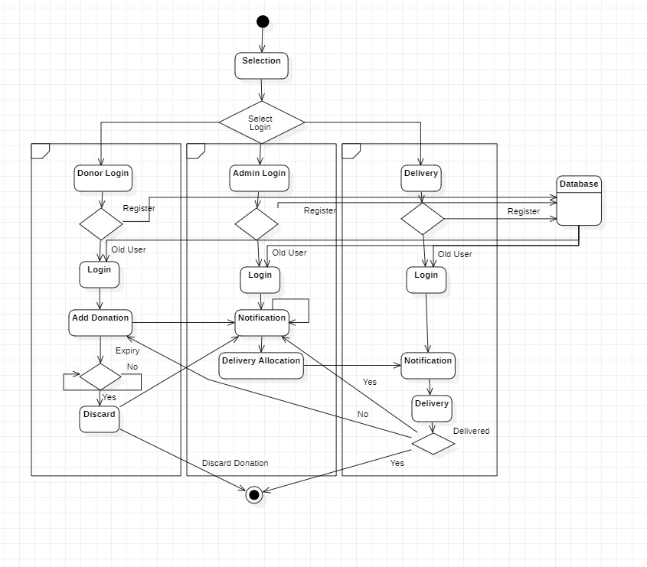
System Architecture
The three separate modules provide distinct functionalities for each module. The donor module allows an user to login and contribute with a donation.
If a donation is not booked within a specified time, it expires and is discarded out of the system.
The admin module will allow the admins to manage donations and allocate them to delivery partners and the delivery module will ensure the donation reaches the specific location.

Slide 6
List of Modules
USER MODULE:
The User module is for people who want to donate their extra or leftover food to help reduce food waste. It accepts donations from places like marriage halls, restaurants, or individuals.
Users can register, log in, and donate food through this module. They can choose the type and amount of food they want to donate, and the system will match their donation with nearby people or organizations in need.
Users can also see a list of their past donations. The information from the User module is sent to Admin module for further processing.

Slide 7
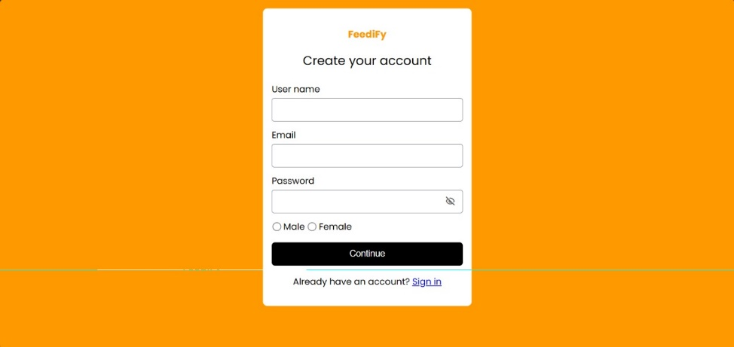
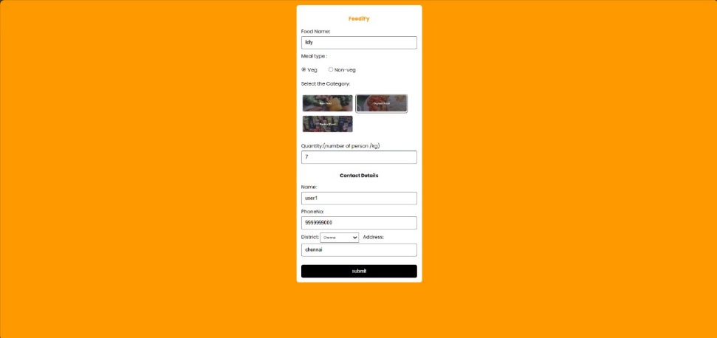
List of Modules
User Module:
Input:
User inputs the details of the food he/she is about to donate into the system.
Output:
Upon successful donation, the user’s profile will get updated with the donation history and personal details.
Functionalities:
Register
Sign In
Donate

Slide 8
List of Modules
ADMIN MODULE:
The Administrator module is for trusts, NGOs, and charities registered on the platform. It helps system administrators manage the food distribution process. When users donate food, the admin module gets this information and lists it for NGOs and charities to choose from.
Admins can view and manage the list of received donations, including the type and amount of food. NGOs and charities can select the donations they need and request a pickup through the Delivery module.
The admin module tracks these requests and keeps records of which organizations have received which donations.

Slide 9
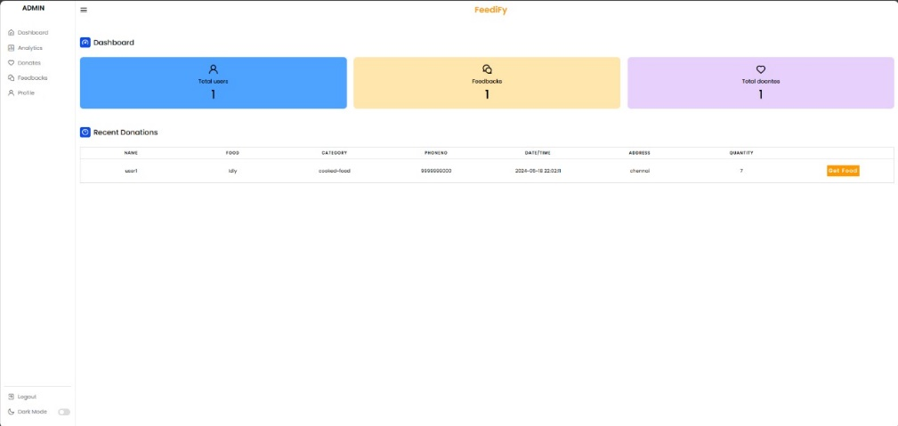
List of Modules
Admin Module:
Input:
Admin can view the bookings that are made by the users.
Output:
The admin can book the order and allocate the orders to the delivery partners.
Functionalities:
Get Food
Allocate Delivery to partners
View Analytics
Log Out

Slide 10
List of Modules
DELIVERY PERSON MODULE:
The Delivery Person module is for people who want to help with the food donation process by providing pickup and delivery services. Delivery personnel can register on the platform.
This module allows them to see which NGOs and charities need food donations picked up and dropped off. It shows the pickup and drop-off locations for each food donation, making it easy for delivery personnel to provide their services.

Slide 11
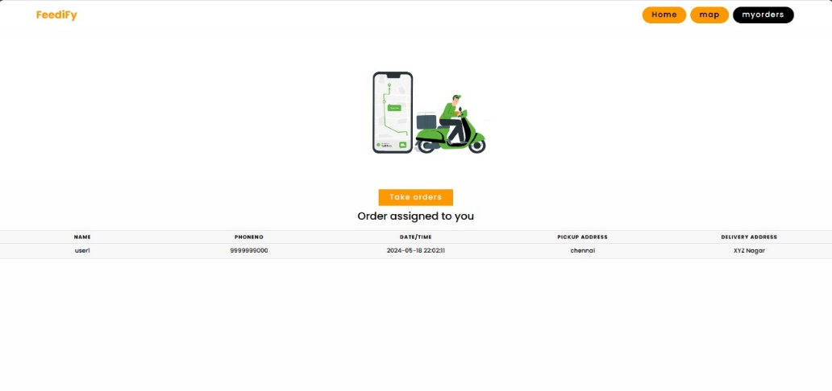
List of Modules
DELIVERY PERSON MODULE:
Input:
The delivery partners can view the active donations which are yet to be delivered
Output:
The delivery partners can take an active order post which it will be removed from the list.
Functionalities:
Log In
Take Order
Log Out

Slide 12
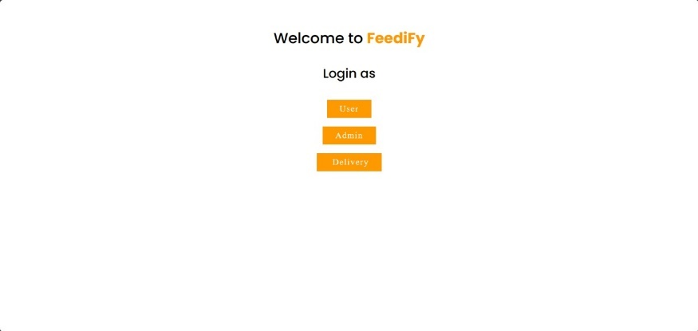
Implementation/Results of Module

Slide 13
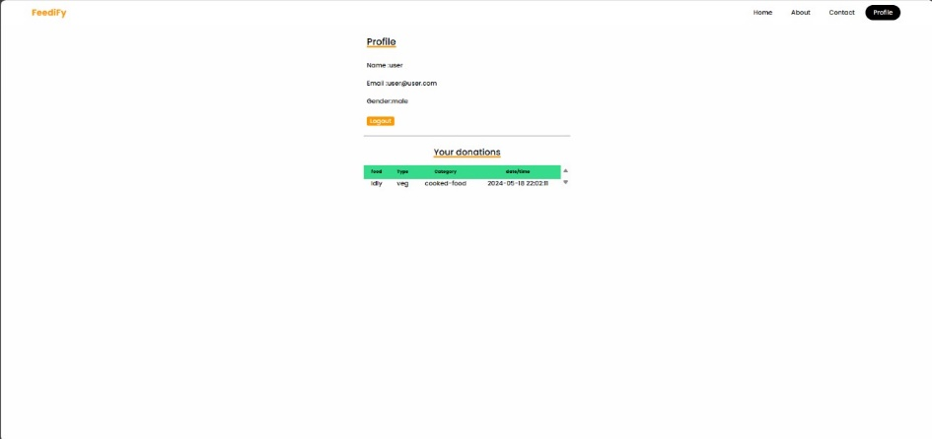
Implementation/Results of Module

Slide 14
Implementation/Results of Module
The project successfully developed a mobile application using React Native to connect food donors with local NGOs, facilitating efficient redistribution of surplus food. Users can easily register, log in, and donate excess food by specifying its type and quantity. The system matches these donations with nearby NGOs and charities. The Administrator module manages the distribution process, listing available donations and tracking which organizations have received them. The Delivery Person module coordinates the pickup and delivery of donations, ensuring timely and accurate distribution. This application helps reduce food waste and address food insecurity by creating a seamless, community-driven food redistribution network.

Slide 15
Conclusion
The application provides a user-friendly platform where food donors, including individuals, restaurants, and businesses, can post details about their surplus food, specifying the type, quantity, and location.
The Administrator module plays a crucial role in managing the food distribution process, receiving donation details from the User module, listing available donations for NGOs, and tracking which organizations have taken which donations. This ensures an organized and efficient redistribution system.
The Delivery Person module coordinates the logistics of picking up and delivering the donations, displaying the pickup and drop-off locations to ensure timely and accurate distribution.

Slide 16
References
[1] Food and Agriculture Organization (FAO), "Global food losses and food waste – Extent, causes and prevention," Rome, 2011.
[2] J. Gustavsson, C. Cederberg, U. Sonesson, R. Van Otterdijk, and A.
Meybeck, "Global food losses and food waste: Extent, causes and prevention," FAO, 2011.
[3] T. Stuart, Waste: Uncovering the Global Food Scandal. Penguin Books,
2009.
[4] J. Parfitt, M. Barthel, and S. Macnaughton, "Food waste within food supply chains: Quantification and potential for change to 2050," Philosophical Transactions of the Royal Society B: Biological Sciences, vol. 365, no. 1554, pp. 3065-3081, 2010.

Slide 17
Github Link
Github Link:
https://github.com/Vikram-Srinivasann/210701504-CS19621-PRIEE

Slide 18
Thank You

